Slide 1
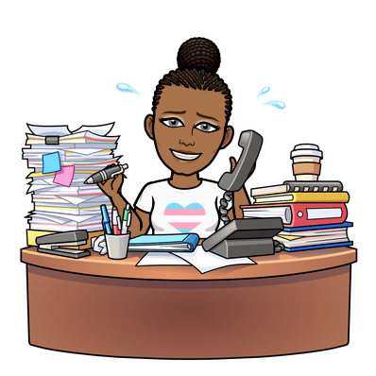
All About Me
I am...
I am a teacher.
I am passionate and kind.
I am respectful.
I am loving and understanding.
I believe...
I believe you are smart.
I believe you are somebody.
I believe that you are unique.
I believe you can and will learn.
I believe you can try.
I believe you are a conquerer.
I believe in you!
Ms. B. Jenkins
My favorite book:
The Holy Bible
My favorite song: https://www.youtube.com/watch?v=IYzlVDlE72w
My favorite quote:
‘It is not where you are that matters, it is where you are going.’

